Slide 1
SmartRide – AI Powered Car Rental System
Developed using React, Spring Boot & MongoDB
DEVELOPED BY : Kishore M
Domain: Full Stack Web Development

Slide 2
Abstract
The SmartRide Car Rental System is a web-based platform designed to simplify the process of renting cars online. It allows admins to add and manage car details, while users can book vehicles based on availability. The system automates pricing by calculating the total cost based on the selected duration, ensuring efficient and transparent transactions.

Slide 3
⚙️ Existing System
Manual booking through calls or physical visits.
Data stored on paper or spreadsheets.
Prone to human errors and double booking.
No centralized record for tracking vehicles or customers.

Slide 4
🚀 Proposed System
Fully automated car rental management using React, Spring Boot, and MongoDB.
Admins can add, view, and manage cars easily.
Users can book cars by selecting dates — total price calculated automatically.
Real-time updates reflect in the database instantly.

Slide 5
💡Advantages
User-friendly and responsive interface.
Real-time database updates with MongoDB.
Automated price calculation reduces manual errors.
Centralized data management and faster access.

Slide 6
⚠️ Disadvantages
Requires internet connectivity.
Server downtime affects accessibility.
Initial setup requires backend and database configuration.

Slide 7
🖥️ Hardware Requirements
Processor: Intel i3 or above
RAM: Minimum 4GB
Storage: 500MB for project files
System: Windows / macOS / Linux

Slide 8
🧰 Software Requirements
Frontend: ReactJS
Backend: Spring Boot (Java)
Database: MongoDB
Tools: VS Code, MongoDB Compass, Postman
Server: Node.js & Java JDK

Slide 9
🧩Modules
Admin Module – Add and manage cars.
User Module – View and book available cars.
Booking Module – Calculate price and store booking details.
Database Module – Store car and booking information in MongoDB.

Slide 10
🔍Module Description
Admin Module: Handles adding car details (name, brand, price, availability).
User Module: Displays car list and allows booking.
Booking Module: Calculates total price based on selected date range.
Database Module: Stores and retrieves all data dynamically.

Slide 11
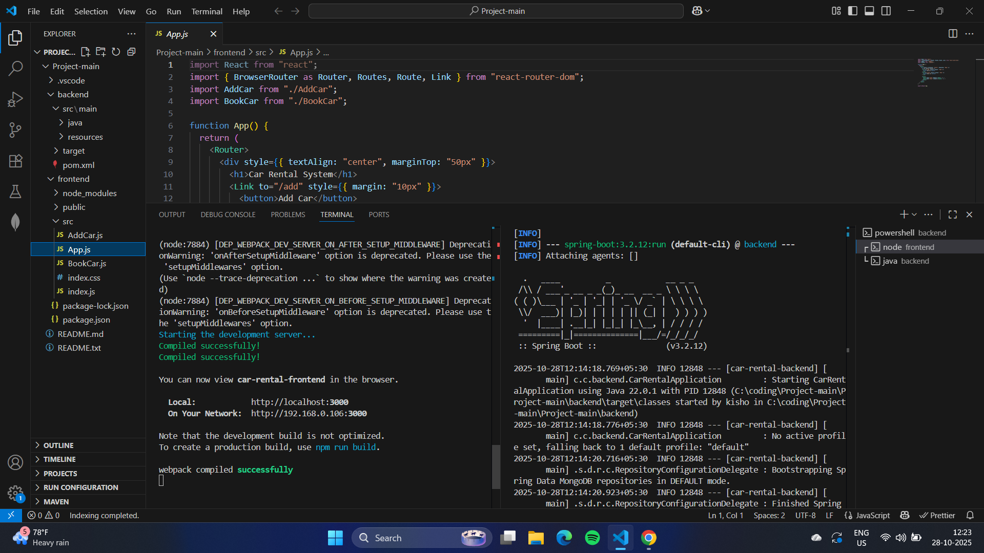
Sample OUTPUT – backend and frontend connected n terminal

Slide 12
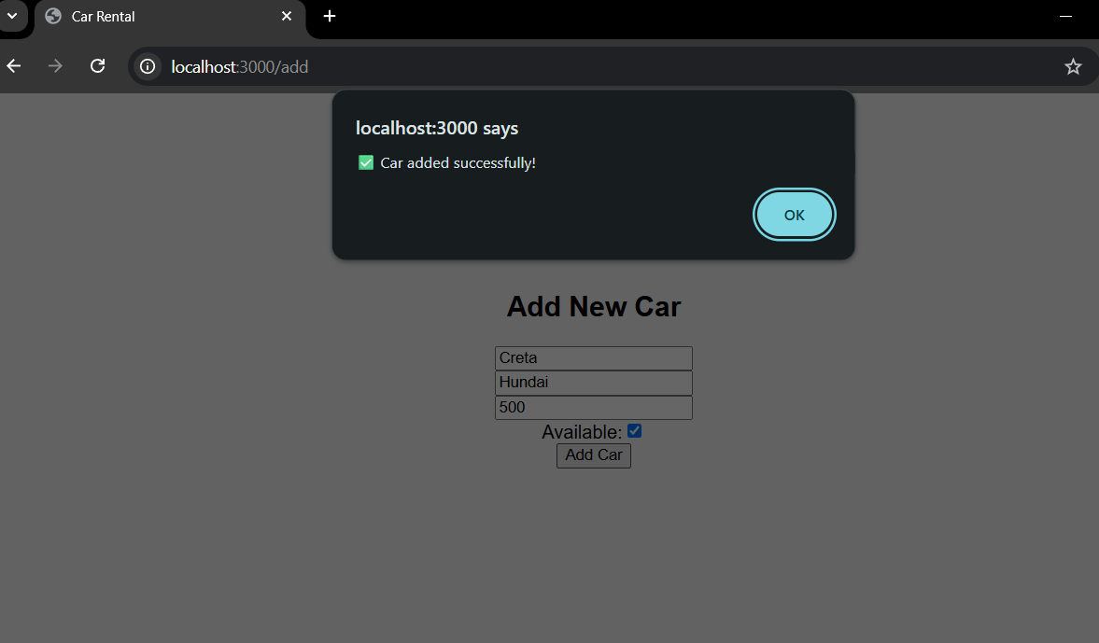
Car added

Slide 13
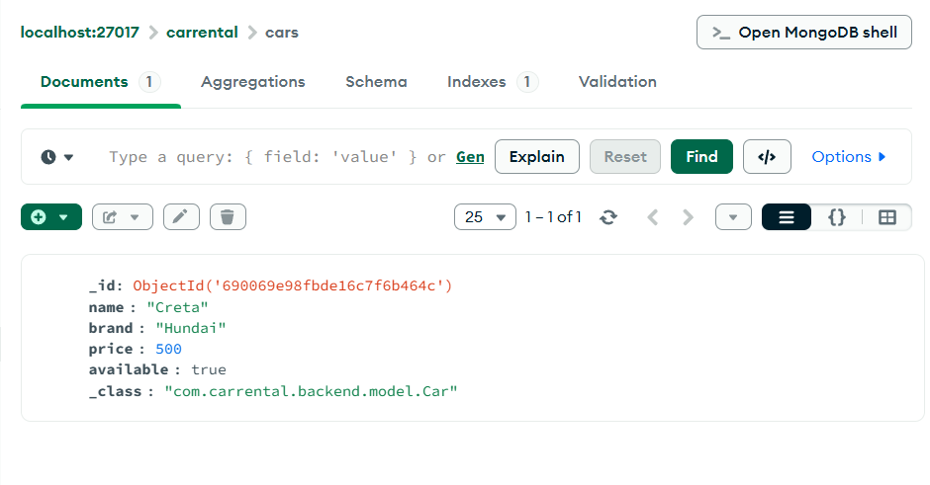
Car Added in frontend showing in database

Slide 14
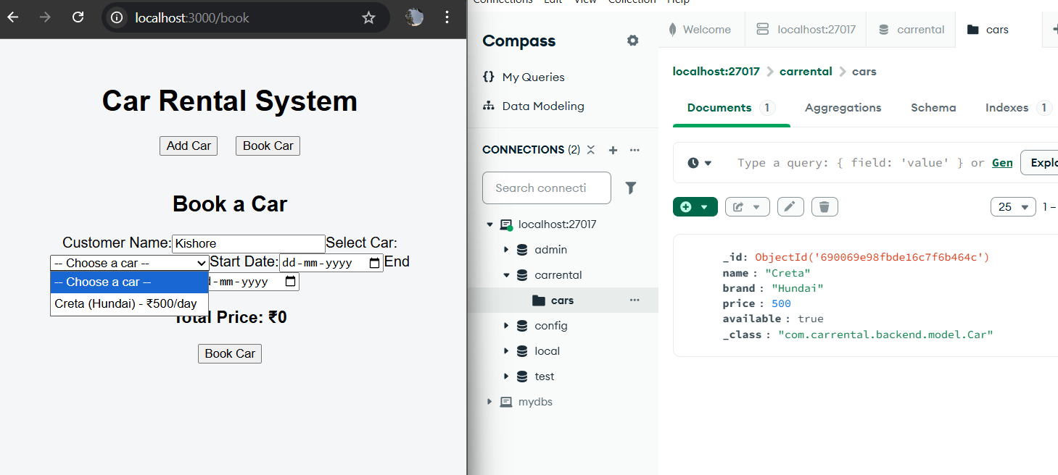
Added car showing in book car page

Slide 15
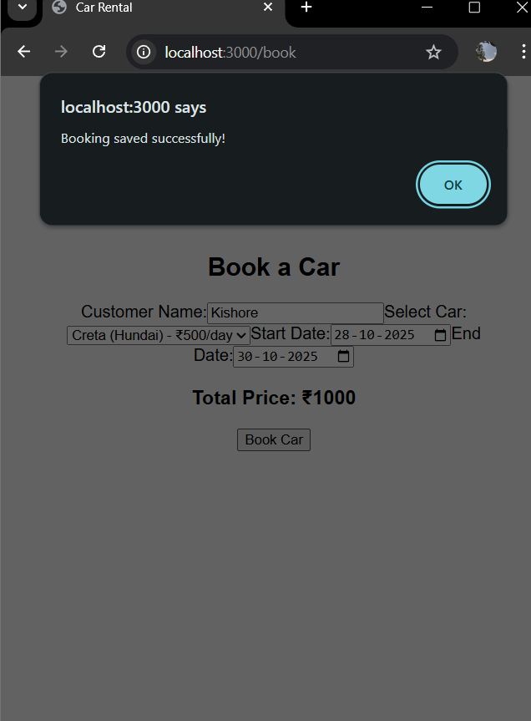
Car booking , total price showing according to number of days

Slide 16
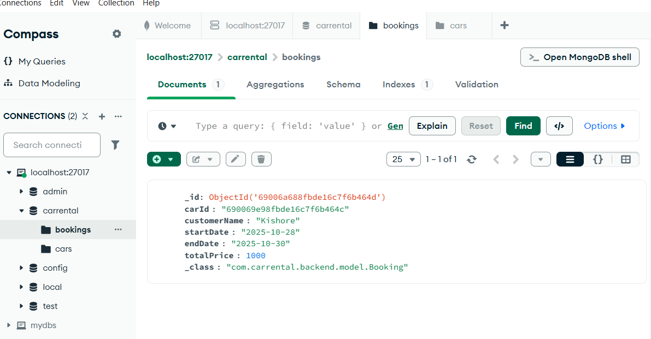
Booking details showing in database

Slide 17
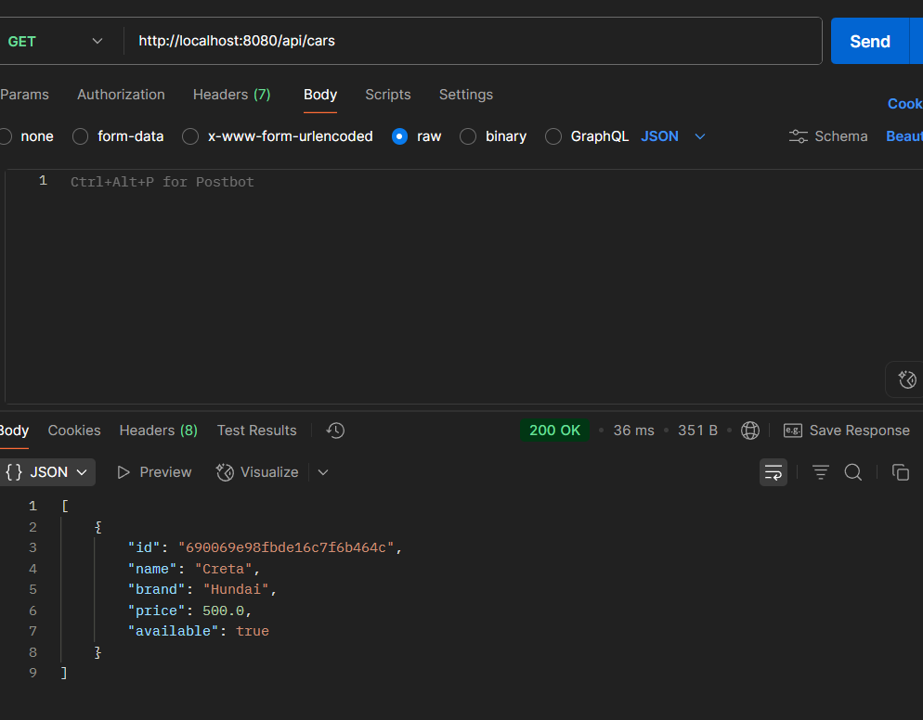
Postman , showing cars

Slide 18
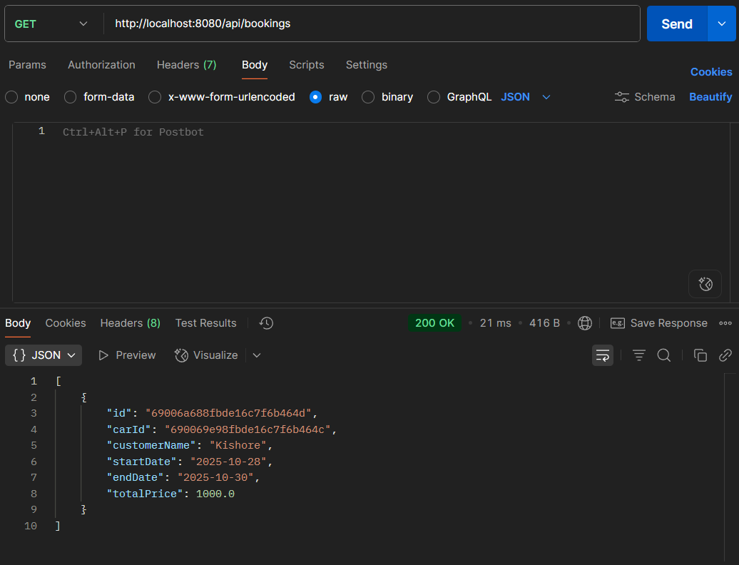
Postman showing bookings

Slide 19
🏁 Conclusion
The SmartRide Car Rental System successfully digitizes the vehicle rental process by integrating a modern web interface with a powerful backend. It provides faster bookings, error-free data handling, and a scalable design — making it an efficient solution for car rental businesses.

Slide 20


